Slide 1


Weekly Presentation
Serpentine Project
28th Cycle
Chemical composition differences
controlling serpentine polymorph
Shichao Ji, Zhou Zhang, Fang Huang

Slide 2
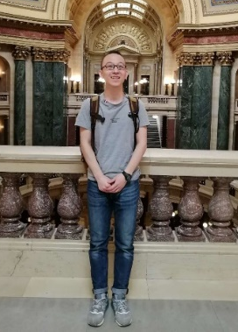





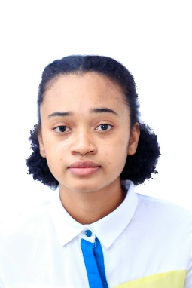
Inactive
Trisha Tunguia
Arka Sahu
Rollan Paul Parakikay
Ashish Kurmer
Chi Chen
Shichao Ji
Guangzhou Institute of Geochemistry, Guangzhou, ZJU
Arka Sahu
Jadavpur University
India, M. Sc
Tuhin Chakraborty
Indian Institute of Technology, Kharagpur
Hejia Zhang
University of California, Los Angeles
Harivelo-Batasoa Anaïg
Athénée Saint Joseph of Antsirabe (ASJA) University
Urmi Ghosh
Indian Institute of Technology, Kharagpur
Priyantan Gupta
Indian Institute of Technology, Kharagpur

Slide 3
Contents
01
Introduction
02
Main purpose
03
Progress
04
Plans for Next Cycle

Slide 4
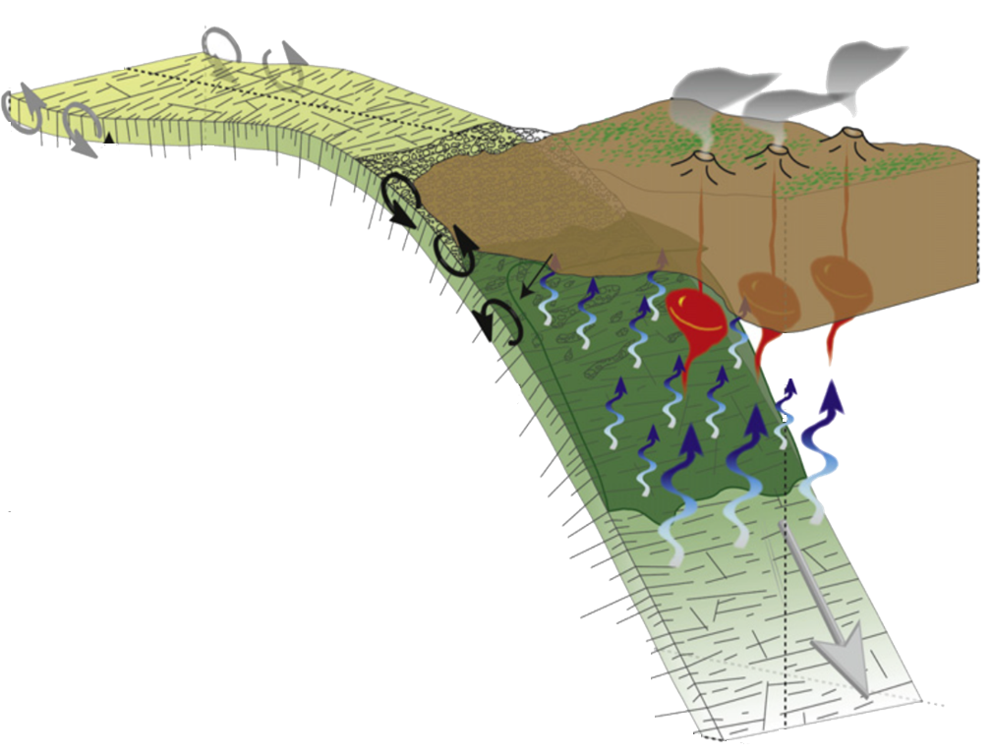
Alteration of the oceanic crust:
1. Mass Transfer:
Crust – Ocean, Surface – Deep
2. Physical and chemical properties of the primary rock:
Porosity, Rheology, Coefficient friction, etc
3. Triger fracture, melt – further fault slip, eruption, earthquake
1
2
1
Process of Subducting
3
Andreani et al., 2018; Deschamps et al., 2013; Lowell, 201; Hacker et al., 2003

Slide 5
Process of alteration
Importance of Serpentine
Main Target
1. Olivine/Plagioclase + H₂O → Serpentine + other minerals + H₂
2. Serpentine is the main product
1. Difference in composition – An important carrier during mass transfer
2. Difference in physical properties – Implication for tectonic activities
Compositional difference in serpentine polymorphs
How?
Implications for the reaction environments and mass transfer process.

Slide 6
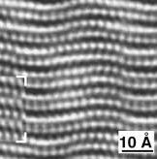
Similar Structure and chemical formula but different morphology
Chrysotile
Lizardite
Antigorite
Fibers
Flat
Wave
Images of chrysotile and lizardite were took through TEM tech. Dóódony et al., 2002
Notes:
So far, three kinds of serpentine are identified, C, L and A. They have similar structure but different morphology.

Slide 7
Chrysotile likes ultramafic rocks, lizardite prefers mafic ones, and antigorite like high T and P environment
Key factors that affect the serpentine polymorph still need further study
Ningthoujam et al., 2012

Slide 8
Major elements difference controlling the serpentine polymorph
Collecting data
Cleaning data
Machine Learning
Results
150-200 papers
NC, NG, EPSL, etc
Training
Predict
Models

Slide 9
Keywords
Publications
Minerals
Chrysotile
Lizardite
Antigorite
ID
Authors (First two)
Date
Ref. name
DOI
ID
Locations
Rock Type
Hosted Rock
Mineralogy
Major Elements
Keywords – I mean the specific mineral. Not a bulk chemistry.
Compositional analysis for the single minerals, not a mixture which contain other minerals.

Slide 10
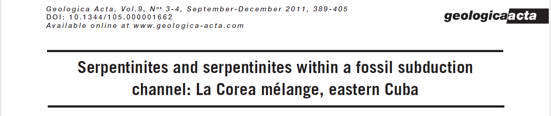
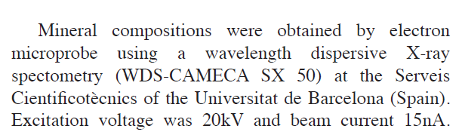
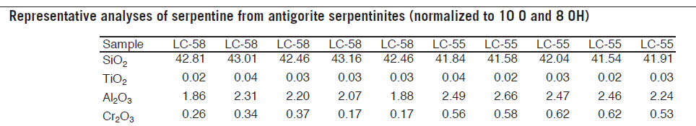
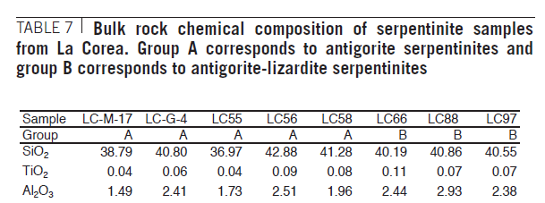
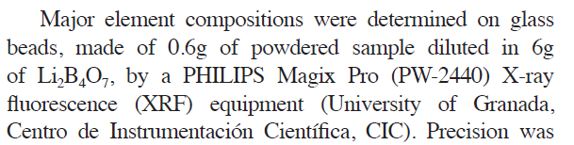
Method – (Ref ID 159)

Slide 11
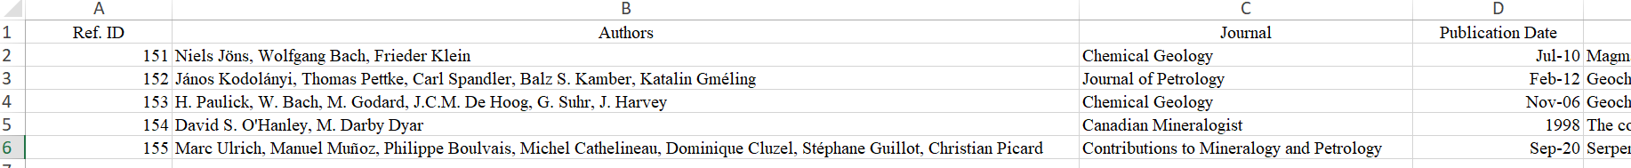
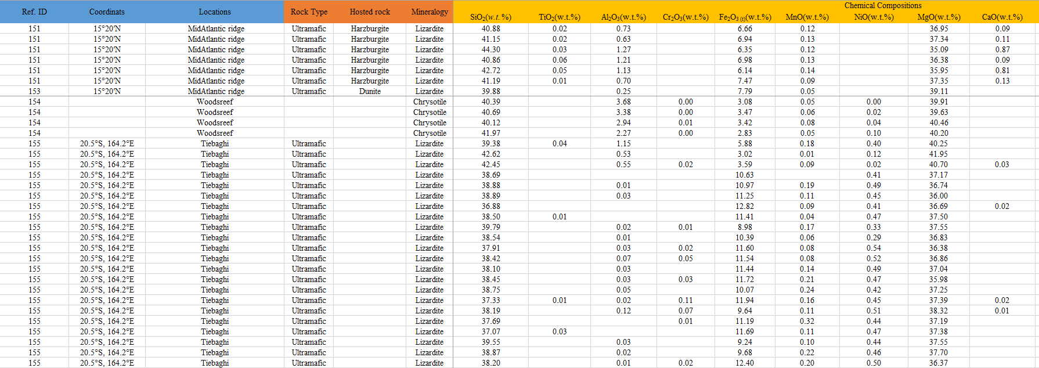
IDs in publications and mineral information should be identical!

Slide 12
Journals, etc
Nature | Lithos
Science | Publications by AGU
Natural Geoscience | Journal of Petrology
Natural Communication | Chemical Geology
Geology | Contributions to Mineralogy and Petrology
American Mineralogist | Minerals
Canadian Mineralogist | Clay minerals
Earth and Planetary Science Letter | Clay and Clay minerals
Geochimica et Cosmochimica Acta | EarthScience reviews

Slide 13
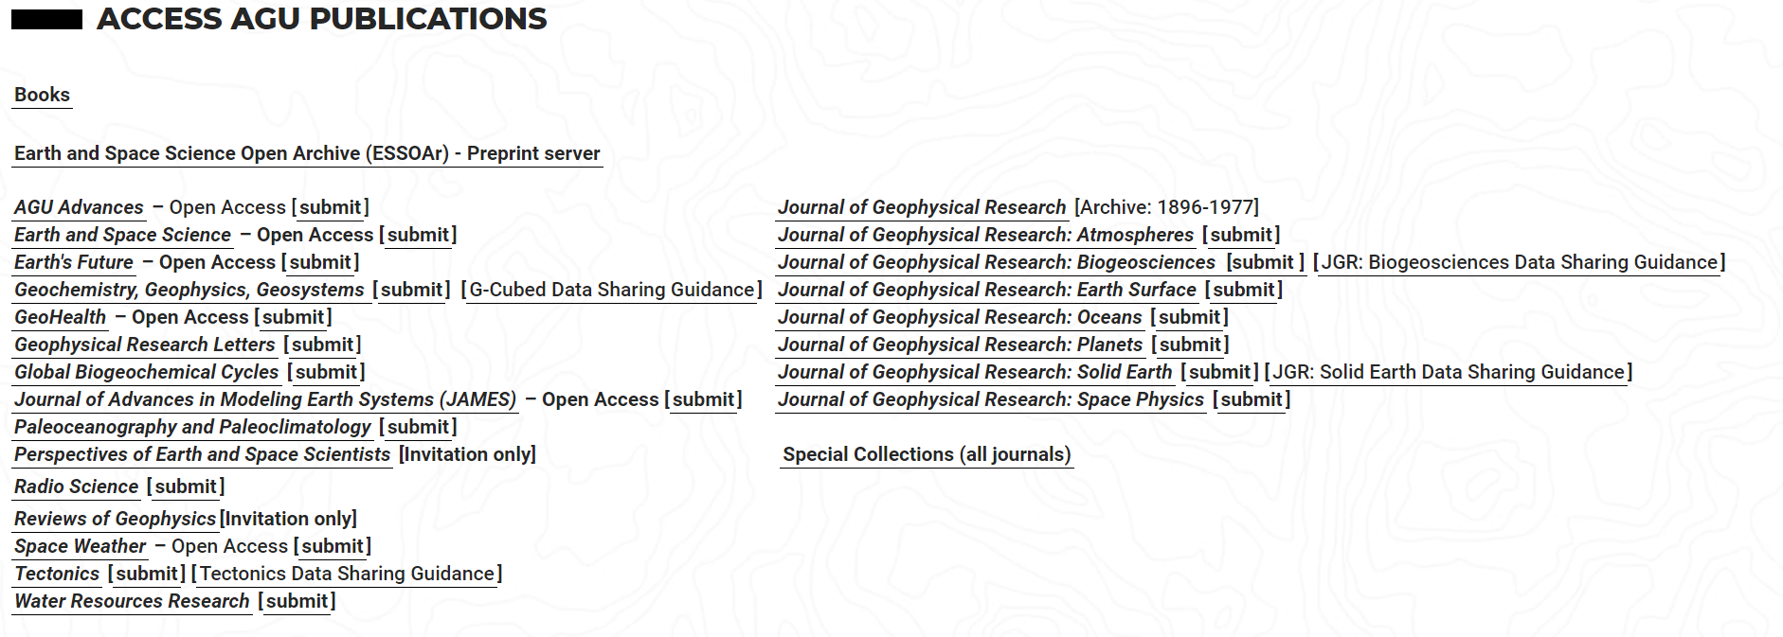
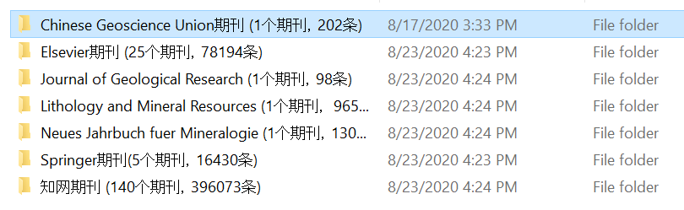
IODP - https://www.iodp.org/
Database

Slide 14
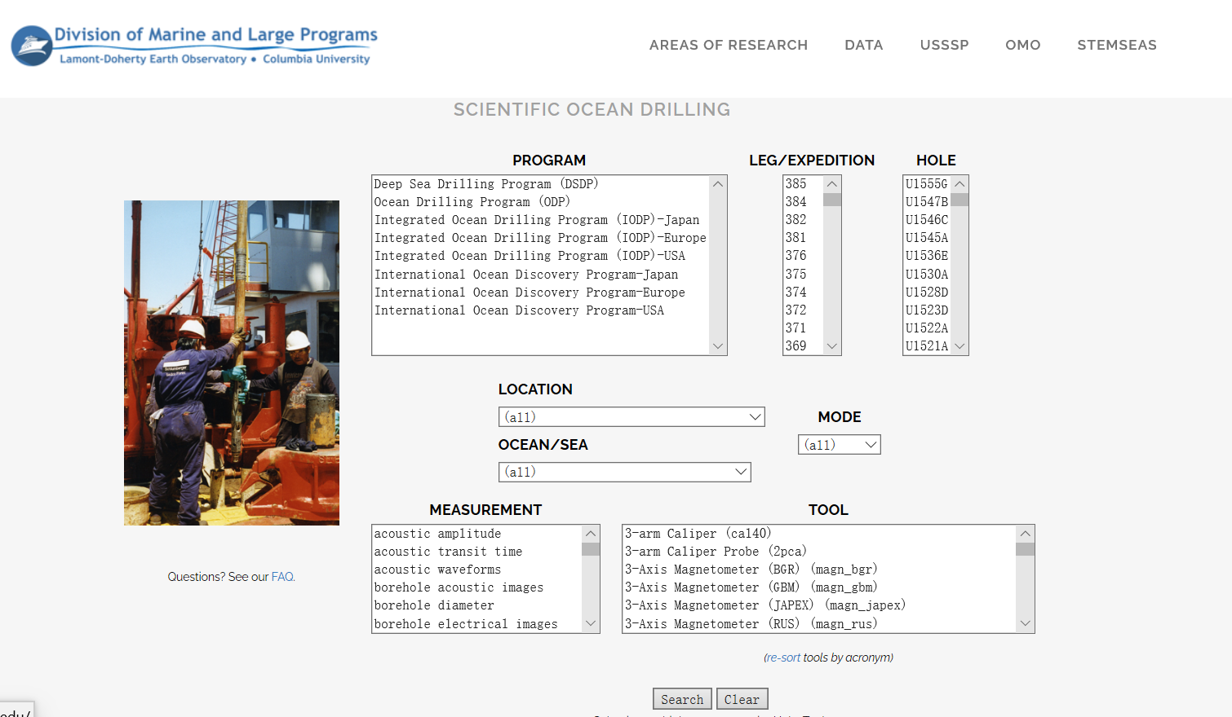
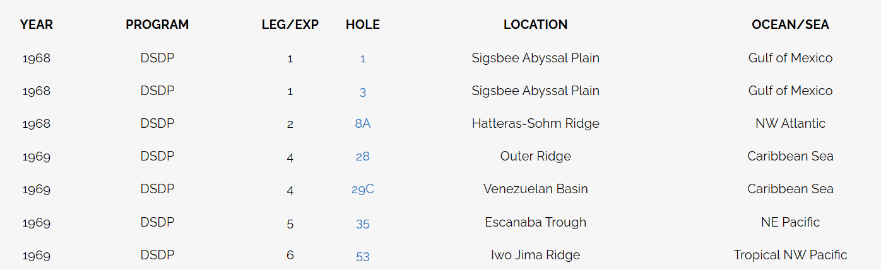
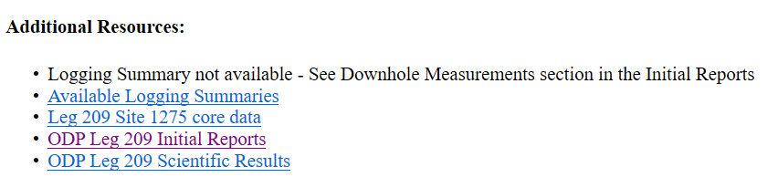
IODP – Several Sources - https://mlp.ldeo.columbia.edu/logdb/scientific_ocean_drilling/
1
2
3

Slide 15
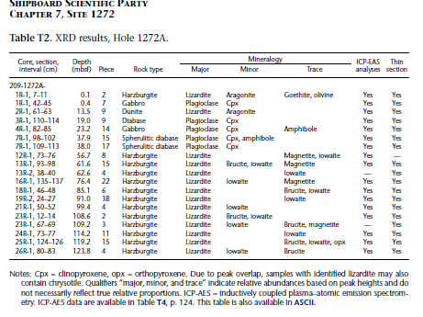
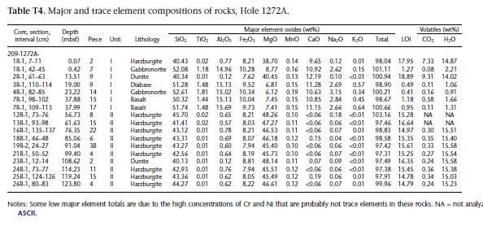
XRD data
Major element compositions
Identify the major minerals
Choose appropriate data

Slide 16
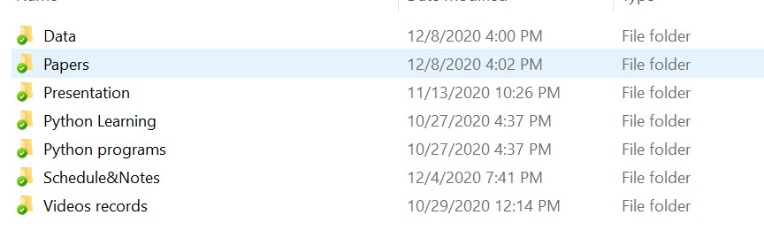

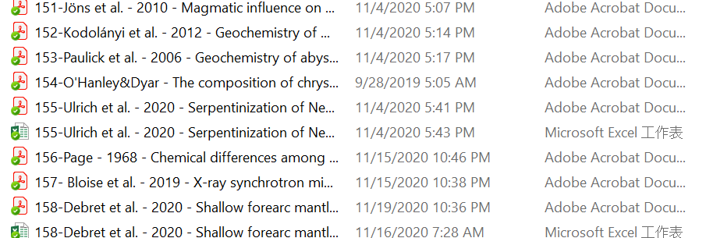
Upload the files that we need to the nutstore cloud
Download data file
Attention
Supplementary materials
Upload information
Name as Information_JSC.xlsx
Templates for naming the papers

Slide 17
Google doc -
https://docs.google.com/spreadsheets/d/1od1xmp8FeNdqjkwk53PElSfQ-2oFtEpkO7ikguDvIzU/edit
Sources for python lessons and presentations
Bilibili - https://space.bilibili.com/616904352?spm_id_from=333.788.b_765f7570696e666f.1
Youtube - https://www.youtube.com/channel/UCu0R4jq3DPlAhtWcYcjxkLQ

Slide 18
Collecting data
Keywords: Chrysotile, Lizardite, Antigorite

Slide 19
Weekly Presentation
Serpentine Project
Thanks! Q&A
Chemical composition differences
controlling serpentine polymorph
Shichao Ji, Zhou Zhang, Fang Huang

Slide 20
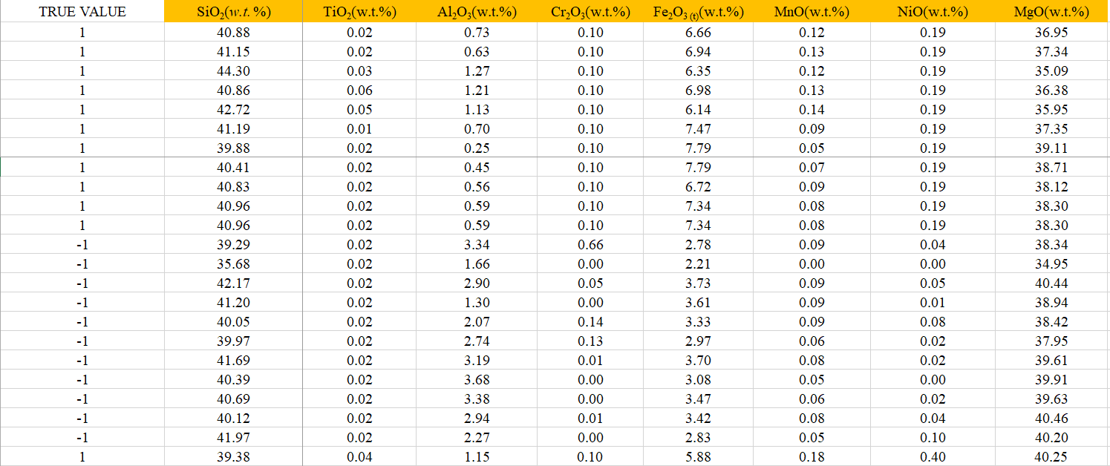
True Value - Chrysotile = -1, Lizardite = 1
Data collected: 123 x 8; Blank cell is filled with median value of that column
Notes:
Antigorite

Slide 21
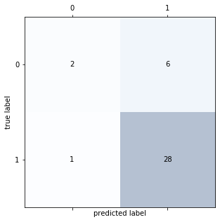
True Value - Chrysotile = 0, Lizardite = 1
SVM results
Accuracy: 0.811
ROC AUC: 0.608
Precision: 0.824
Recall: 0.966
F1 Score: 0.889
Confusion matrix
Data collected: 123 x 8; Blank cell is filled with median value of that column
Notes:
Standard

Slide 22
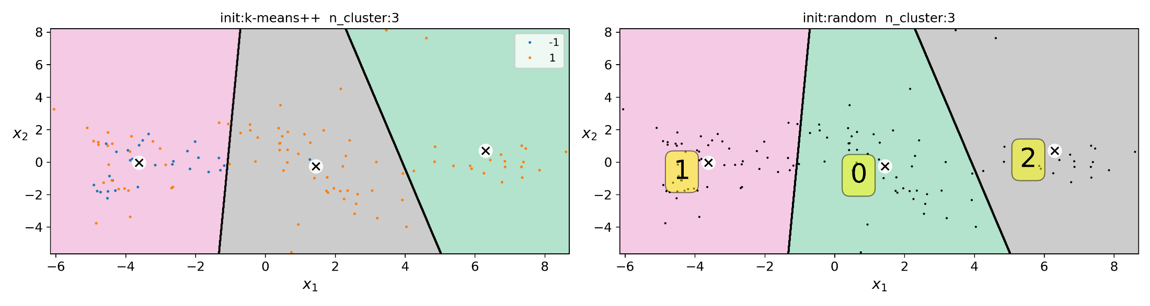
Kmeans – Chrysotile = -1, Lizardite = 1
3 clusters were identified, and points are well disturbed.
Points representing chrysotile (negative value) were disturbed in pink area.
Notes:
3 clusters distribution, score of the Kmeans, enough data

